Slide 1
Unit I Computer Evolution and Arithmetic

Slide 2
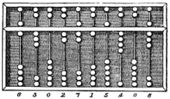
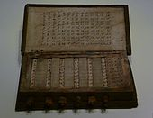
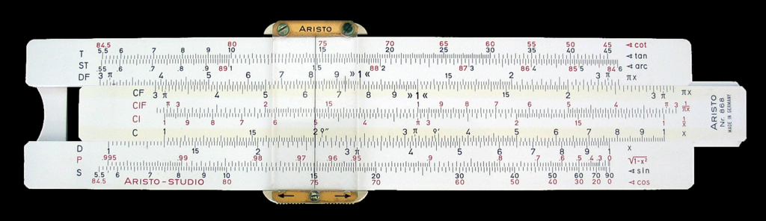
Ancient era
Napiers bones
Abacus
What was before this ?

Slide 3
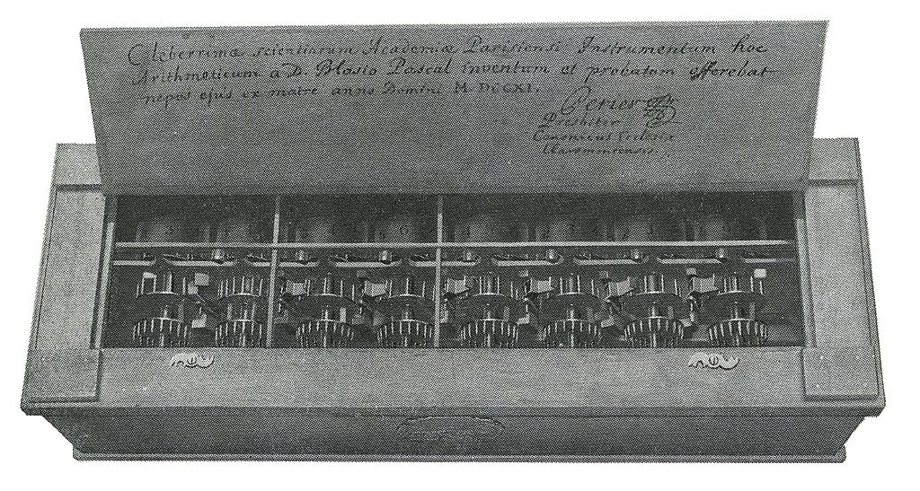
Zero Generation : Mechanical Era (1600-1940)
Wilhelm Schickhard and Blaise Pascal (1623-1642)
: built a mechanical counter with carry

Slide 4
Charles Babbage
originated the concept of a programmable computer.
Considered the "father of the computer",
he conceptualized and invented the first mechanical computer in 1833
he realized that a much more general design, an Analytical Engine, was possible. The input of programs and data was to be provided to the machine via punched cards, a method being used at the time in mechanical looms such as the Jacquard loom.

Slide 5
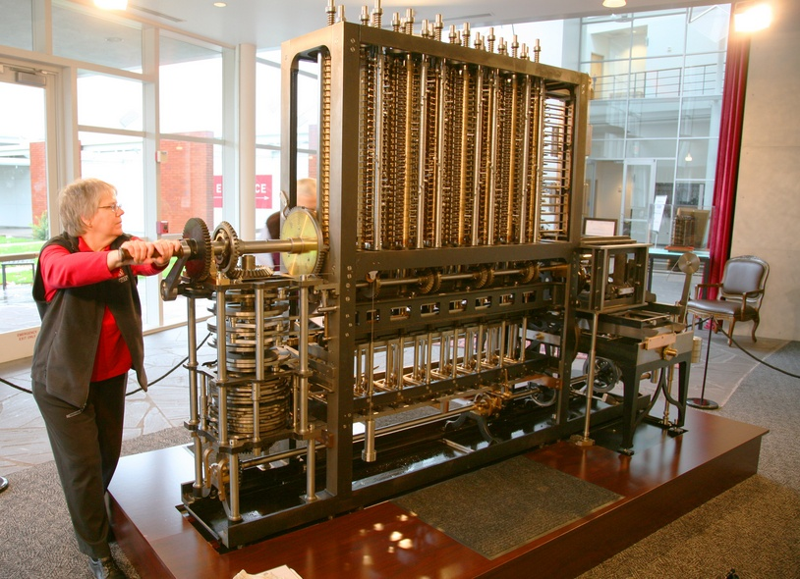
Babbage’s Differential Engine
This machine used the decimal number system and was powered by cranking a handle. To approximate logarithmic and trigonometric functions, by polynomials

Slide 6
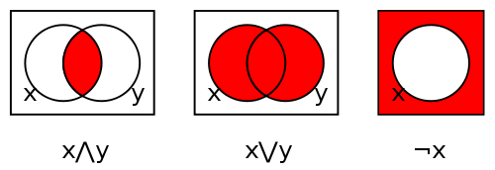

George Boole (1847)
Boolean algebra is the subarea of algebra in which the values of the variables are the truth values true and false, usually denoted 1 and 0 respectively.
elementary algebra uses values of the variables are numbers & operations are addition and multiplication,
Boolean algebra operations are the conjunction and(∧), the disjunction or ( ∨), and the negation not (¬).

Slide 7
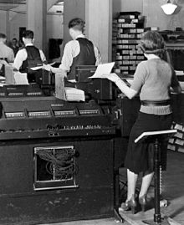
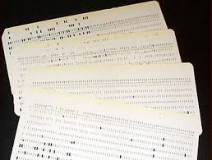
Herman Hollerith (1880) – Punched Cards

Slide 8
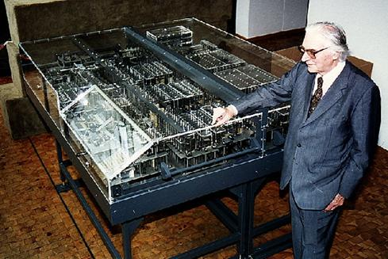
Konrad Zuse (1938):Automatic Calculating Machine based on Electromagnetic mechanism

Slide 9
First Generation (1946-1957): Vacuum Tubes
Late 1940s and 1950s
Stored-program computers
Programmed in assembly language
Used magnetic devices and earlier forms of memories
Examples: IAS, ENIAC, EDVAC, UNIVAC, Mark I, IBM 701

Slide 10
1943-44: John Mauchly (professor) and J. Presper Eckert (graduate student) built ENIAC (Electronic Numerical Integrator and Computer) at U. Penn.
1944: Howard Aiken used “separate data and program memories” in MARK I computer – Harvard Architecture.
1945-52: John von Neumann proposed a “stored program computer” EDVAC (Electronic Discrete Variable Computer) – Von Neumann Architecture – use the same memory for program and data.

Slide 11
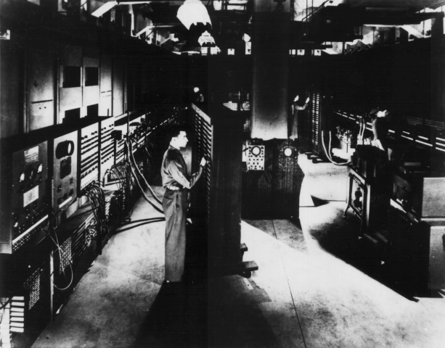
ENIAC – background
Electronic Numerical Integrator And Computer
Eckert and Mauchly
University of Pennsylvania
Trajectory tables for weapons
Started 1943
Finished 1946
Too late for war effort
Used until 1955

Slide 12
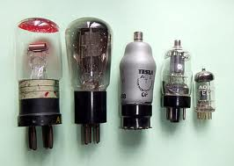
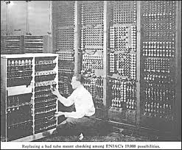
ENIAC - details
Decimal number system used (not binary)
20 accumulators of 10 digits
Programmed manually by switches : programming by Plugging and Unplugging of switches ,Results were punched on cards or printed on type writer
18,000 vacuum tubes
30 tons
15,000 square feet
140 kW power consumption
5,000 additions per second

Slide 13
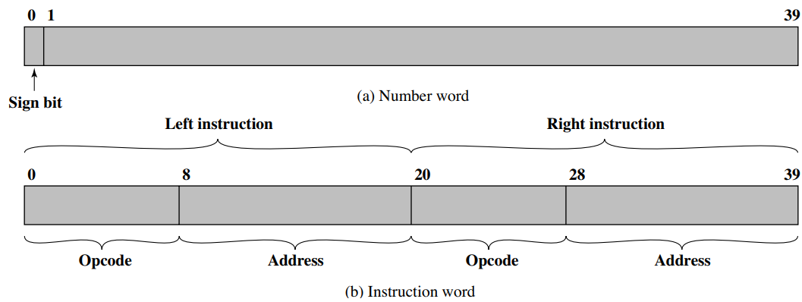

Slide 14
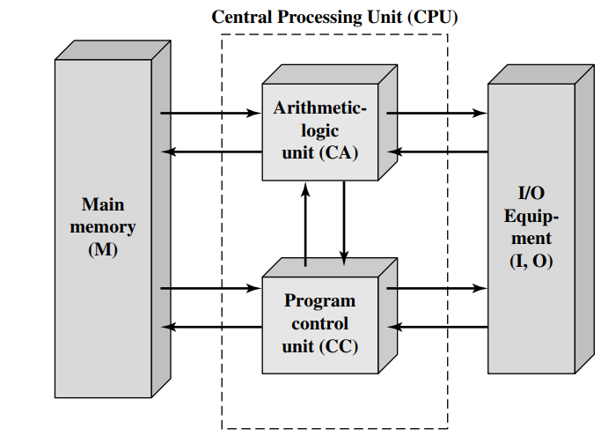
IAS
von Neumann and his colleagues , designed in 1952

Slide 15
Commercial Computers
1947 - Eckert-Mauchly Computer Corporation
UNIVAC I (Universal Automatic Computer)
US Bureau of Census 1950 calculations
Became part of Sperry-Rand Corporation
Birth of IBM and Sperry in 1950s.
1953-IBM 701 for scientific calculations
1955-IBM 702 for Business Application

Slide 16
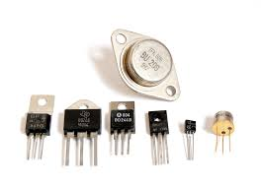
Second Generation (1955-1965) :Transistors
Replaced vacuum tubes
Smaller, Cheaper
Less heat dissipation
Solid State device
Made from Silicon (Sand)
Invented 1947 at Bell Labs
Multiplexer, Data Channel
Concept of System Software

Slide 17
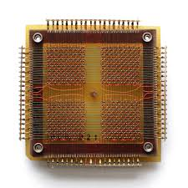
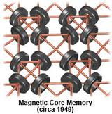
Magnetic core memories
Floating-point arithmetic
High-level languages used: ALGOL, COBOL and FORTRAN
System software: compilers, subroutine libraries, batch processing
Examples:
IBM 7000, IBM 7094, DEC – 1957, PDP-1

Slide 18
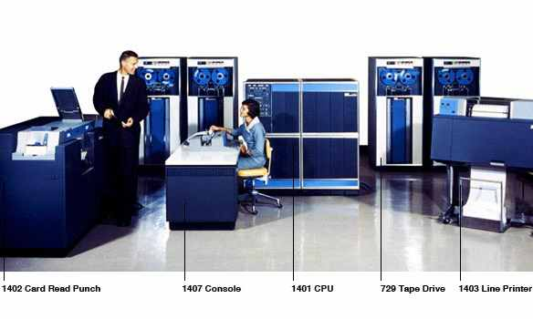

Slide 19
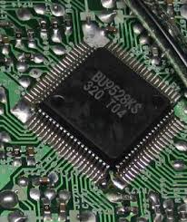
Third Generation (1965-1971) : Integrated Circuit
Literally - “small electronics”
A computer is made up of gates, memory cells and interconnections
Integrated circuit (IC) technology
Semiconductor memories
Memory hierarchy, virtual memories and caches
Time-sharing OS
Parallel processing and pipelining
Microprogramming
Examples:
IBM 360 & 370, ILLIAC IV, DEC PDP8 and VAX, Amdahl 470

Slide 20
All Generations of Computer
Vacuum tube - 1946-1957
Transistor - 1958-1964
Small scale integration - 1965 on
Up to 100 devices on a chip
Medium scale integration - to 1971
100-3,000 devices on a chip
Large scale integration - 1971-1977
3,000 - 100,000 devices on a chip
Very large scale integration - 1978 to date
100,000 - 100,000,000 devices on a chip
Ultra large scale integration
Over 100,000,000 devices on a chip

Slide 21
Intel
1971 - 4004
First microprocessor
All CPU components on a single chip
4 bit
Followed in 1972 by 8008
8 bit
Both designed for specific applications
1974 - 8080
Intel’s first general purpose microprocessor

Slide 22
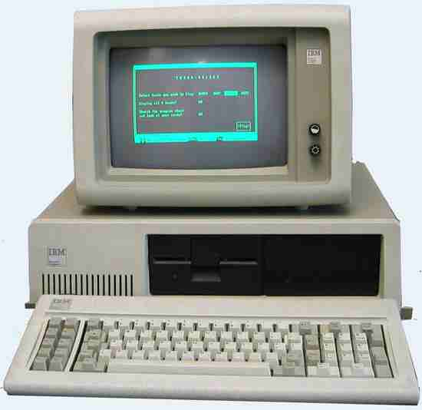

Slide 23
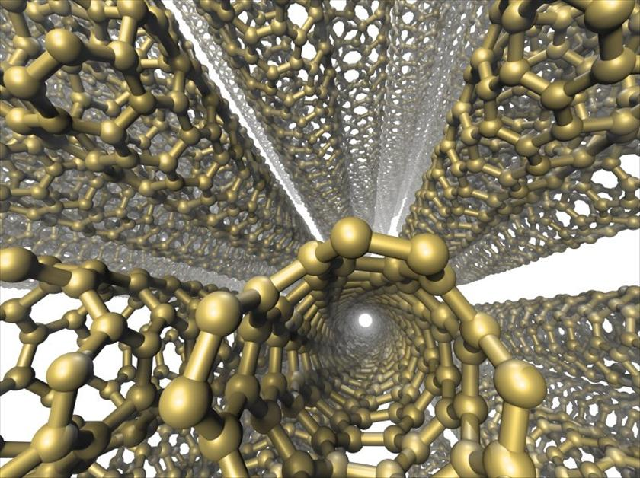
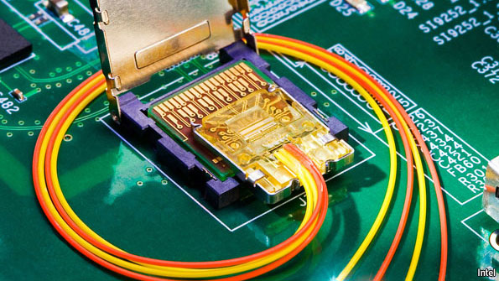
5th generation

Slide 24
Intel
1971 - 4004
First microprocessor
All CPU components on a single chip
4 bit
Followed in 1972 by 8008
8 bit
Both designed for specific applications
1974 - 8080
Intel’s first general purpose microprocessor

Slide 25
Pentium Evolution (1)
8080
first general purpose microprocessor
8 bit data path
Used in first personal computer – Altair
8086
much more powerful
16 bit
instruction cache, prefetch few instructions
8088 (8 bit external bus) used in first IBM PC
80286
16 Mbyte memory addressable
up from 1Mb

Slide 26
Pentium Evolution (2)
80386
32 bit
Support for multitasking
80486
sophisticated powerful cache and instruction pipelining
built in maths co-processor
Pentium
Superscalar
Multiple instructions executed in parallel

Slide 27
Pentium Evolution (3)
Pentium Pro
Increased superscalar organization
Aggressive register renaming
branch prediction
data flow analysis
speculative execution

Slide 28
32-bit processors: P5 microarchitecture , Pentium with MMX Technology
32-bit processors: P6/Pentium M microarchitecture
Pentium Pro ,II, Celeron,III,M, Intel Core, Dual-Core Xeon LV
32-bit processors: NetBurst microarchitecture
Pentium 4, Xeon, 4F
64-bit processors: IA-64
Itanium 1,2
64-bit processors: Intel 64 – NetBurst microarchitecture
Pentium 4F,D, Xeon
64-bit processors: Intel 64 – Core microarchitecture
Xeon , Intel Core 2 , Dual-Core
64-bit processors: Intel 64 – Nehalem microarchitecture
Intel Pentium ,i3,i5,i7, Xeon
64-bit processors: Intel 64 – Sandy Bridge / Ivy Bridge microarchitecture
Celeron , Pentium , Core i3 ,i5, i7(3.50 GHz price Rs 23K,)
64-bit processors: Intel 64 – Haswell microarchitecture

Slide 29
Microprocessor manufacturers
AMD
ARM Holdings
Cyrix
Freescale
Intel
IBM
Marvell
NexGen
Nvidia Tegra
Oracle (previously Sun)
OWC
Qualcomm
Rise Technology
Samsung
SigmaTel
Sonnet
Texas Instruments
Transmeta
tilera
Via (Centaur Technology division)
winchip

Slide 30
Generations of Computer
Generation | Era | Basic element used | Examples
0 | Till 1946 | Mechanical counter | Mechanical counter with carry
1 | 1946-57 | Vacuum Tubes | ENIAC, EDVAC, UNIVAC
2 | 1958-64 | Transistor | IBM 7000, IBM 7094, DEC- 1957, PDP-1
3 | 1965-71 | Integrated Circuit (SSI,MSI) | IBM 360 and 370, DEC PDP8
4 | 1972-77 | Microprocessors (LSI) | 4004,8085,8086
5 | 1978-91 | Microprocessors (VLSI,ULSI) | Pentium,…. i7

Slide 31
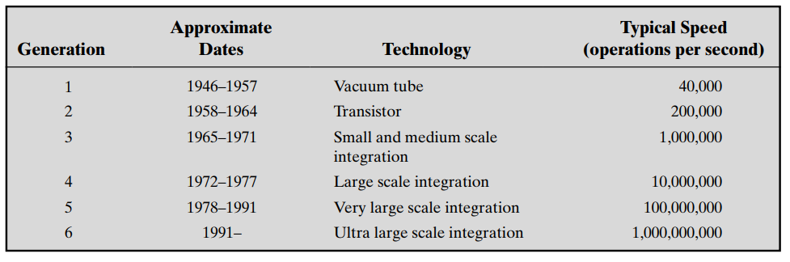
Ref: Stallings

